Slide 1
Computational Assignment Submit hand written Submission date Saturday 28/04/2018 Marks = 100

Slide 2
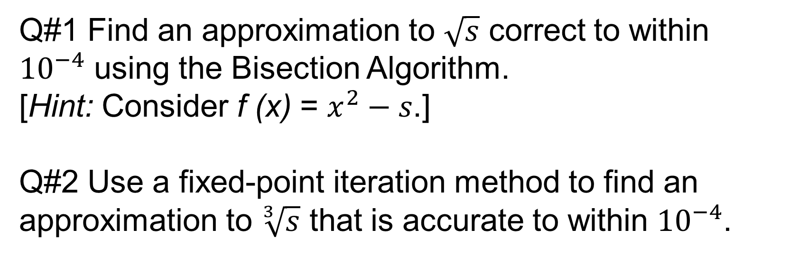
s = last two digits of your seat number
Q#1 Find an approximation to $\sqrt{s}$correct to within ${10}^{−4}$using the Bisection Algorithm.
[Hint: Consider f (x) = $x^{2}−s$.]
Q#2 Use a fixed-point iteration method to find an approximation to $\sqrt[3]{s}$ that is accurate to within ${10}^{−4}$.

Slide 3
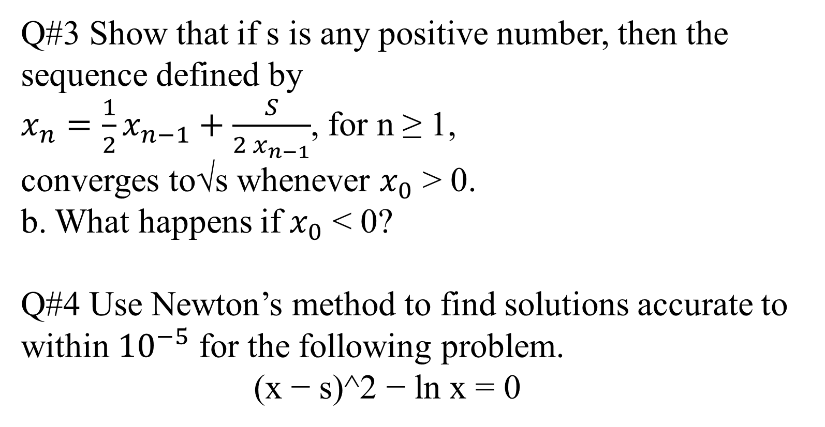
Q#3 Show that if s is any positive number, then the sequence defined by $x_{n}=\frac{1}{2}x_{n−1}+\frac{S}{{2 x}_{n−1}}$, for n ≥ 1, converges to√swhenever $x_{0}$> 0. b. What happens if $x_{0}$< 0? Q#4 Use Newton’s method to find solutions accurate to within ${10}^{−5}$for the following problem. (x − s)^2 − ln x = 0

Slide 4
Q#5 Use appropriate Lagrange interpolating polynomials of degrees one, two, and three to approximate each of the following: f (0.25) if f (−1) = 0.86s9s480, f (−0.5) = 0.9s802s09, f (0) = 1.0s86ss3, f (0.5) = 1.s9s3s67 Q#6 Use the Newton backward-difference formula to construct interpolating polynomials of degree three for the following data. Approximate the specified value using each of the polynomials. a. f (−1/3) if f (−0.75) = −0.0s1s1s50, f (−0.5) = −0.024sss00s, f (−0.25) = 0.3s3s4s950, f (0) = 1.s0s00000

Slide 5
Q#7). Solve dy/dx=ln (x + 3)/( cos (y))
y(1) = 0.5s6
y(1.5)= ?
By
Euler Method
Taylor Method
R.K – 4
Q#8).
R.K -6
Any predicter and corrected method
Find solution by saprable method
viii) Find Error

Slide 6
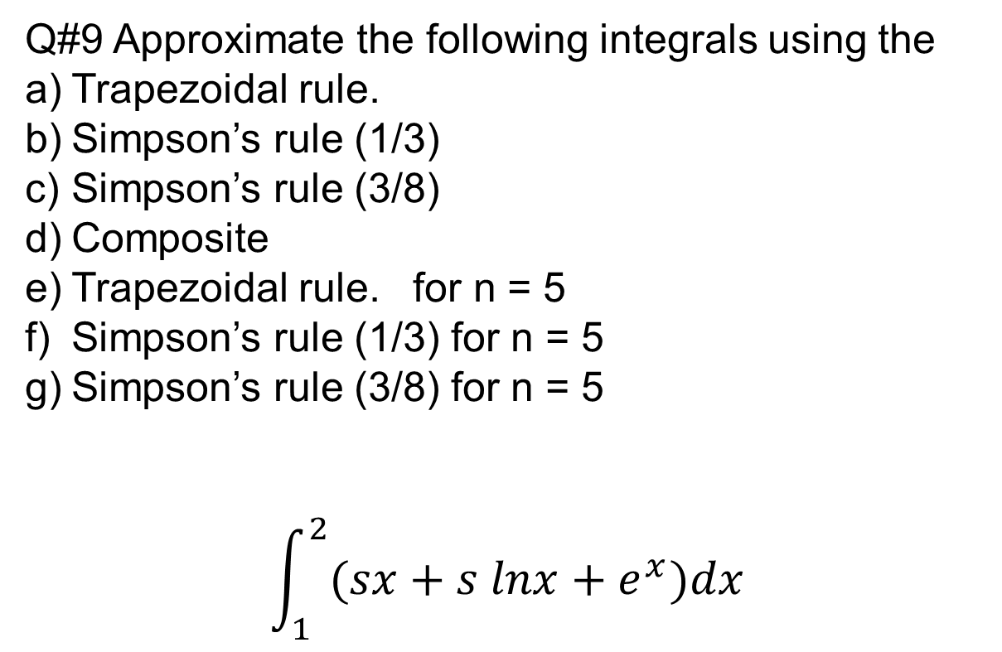
Q#9 Approximate the following integrals using the
Trapezoidal rule.
Simpson’s rule (1/3)
Simpson’s rule (3/8)
Composite
Trapezoidal rule. for n = 5
Simpson’s rule (1/3) for n = 5
Simpson’s rule (3/8) for n = 5
$$\int_{1}^{2}{(sx+s lnx+e^{x})dx}$$

Slide 7
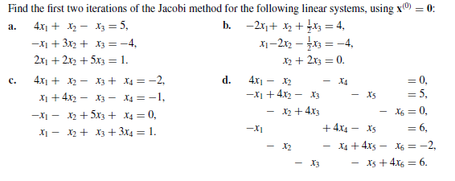
Q#10

Slide 8
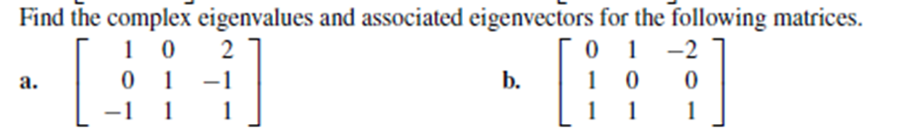
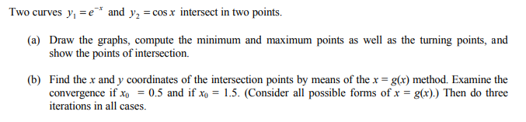
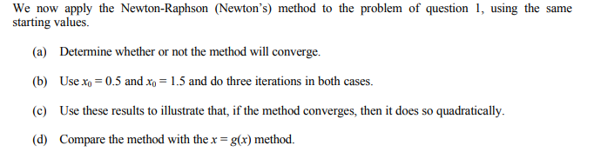
Q#.11
Q#.12 (a)
Q#.12(b)

